Slide 1
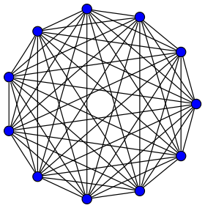
Body (n nodes),
Complete graph
…
Arm (k nodes)
The last node of the arm is connected to all n nodes of body

